Slide 1
ADMN5018 FINAL PROJECT
Dan Magee
Priscilla Okechukwu
Anto Sebastian

Slide 2
contents
1) Dataset and Intended Audience
2) Analytical Error
3) Average Age of Participant
4) Participant Age Group Breakdown
5) Participant Gender Breakdown
6) World Map
7) Conclusion

Slide 3
contents
1) Dataset and Intended Audience
2) Analytical Error
3) Average Age of Participant
4) Participant Age Group Breakdown
5) Participant Gender Breakdown
6) World Map
7) Conclusion

Slide 4
1) Dataset and intended audience
For this project we used a dataset on incidences of gun violence in North America from January 2013 until March 2018.
Our project is intended to give law enforcement officials in the affected areas insight to help them reduce gun violence.

Slide 5
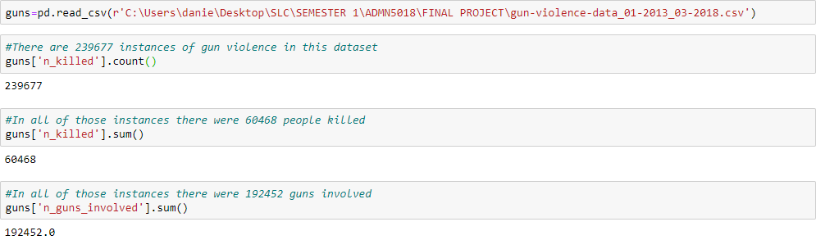
1) Dataset and intended audience

Slide 6
contents
1) Dataset and Intended Audience
2) Analytical Error
3) Average Age of Participant
4) Participant Age Group Breakdown
5) Participant Gender Breakdown
6) World Map
7) Conclusion

Slide 7
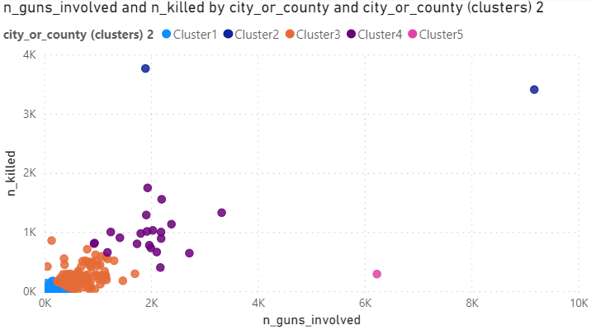
2) Analytical error
When asked about our data in class earlier this semester, we shared this visual below made in Power BI from this data that seems to indicate that the greater the number of guns involved, the more people were killed.

Slide 8
2) Analytical error
The mistake here came from manipulation of the data in the participant age column. We inadvertently created duplicate lines and thusly skewed the data. In fact, most people were killed in instances of gun violence involving fewer guns.

Slide 9
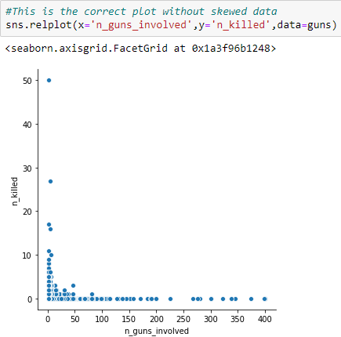
2) Analytical error

Slide 10
2) Analytical error
This posed a dilemma for us. Originally, our intention was to suggest to the law enforcement officials in the affected areas that if they reduce access to guns and increase gun control, then they could reduce deaths from gun violence. Unfortunately, this data does not support that, at least not in that way.

Slide 11
contents
1) Dataset and Intended Audience
2) Analytical Error
3) Average Age of Participant
4) Participant Age Group Breakdown
5) Participant Gender Breakdown
6) World Map
7) Conclusion

Slide 12
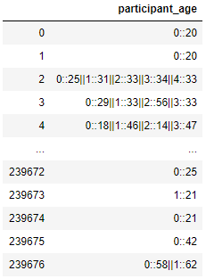
3) Average age of participant
The participant age column is delimited in 2 different ways, double colon and double pipe, necessitating serious data manipulation in order to determine the average age of participant.

Slide 13
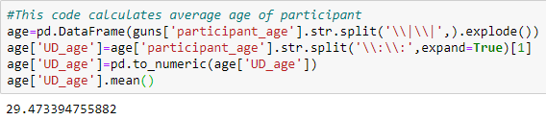
3) Average age of participant
Here we can see the split by the double pipe delimiter exploded into multiple rows, then the double colon delimiter split into another column. Then that new column is converted to numeric data type, and averaged. The average age of participant is 29 and a half.

Slide 14
contents
1) Dataset and Intended Audience
2) Analytical Error
3) Average Age of Participant
4) Participant Age Group Breakdown
5) Participant Gender Breakdown
6) World Map
7) Conclusion

Slide 15
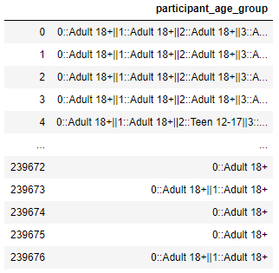
4) Participant age group breakdown
The participant age group column is delimited in the same way as the participant age column and so similar data manipulation is required.

Slide 16
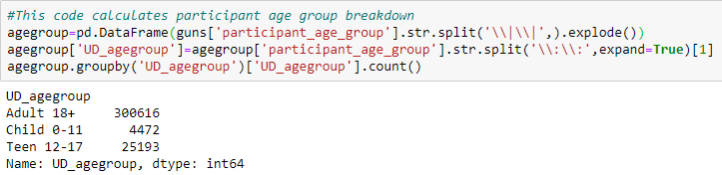
4) Participant age group breakdown
Here we can see the split by the double pipe delimiter exploded into multiple rows, then the double colon delimiter split into another column. Then a groupby shows that there are 300616 adult participants, 25193 teenage participants, and 4472 child participants.

Slide 17
contents
1) Dataset and Intended Audience
2) Analytical Error
3) Average Age of Participant
4) Participant Age Group Breakdown
5) Participant Gender Breakdown
6) World Map
7) Conclusion

Slide 18
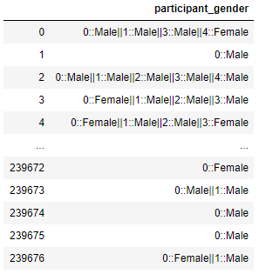
5) Participant gender breakdown
The participant gender column is delimited in the same way as the participant age column and so similar data manipulation is required.

Slide 19
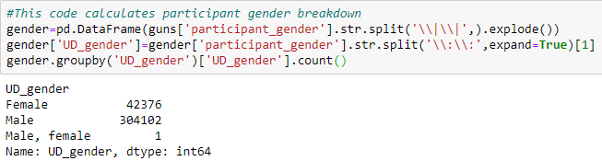
5) Participant gender breakdown
Here we can see the split by the double pipe delimiter exploded into multiple rows, then the double colon delimiter split into another column. Then a groupby shows that there are 304102 male participants, 42376 female participants, and interestingly, one that is both.

Slide 20
contents
1) Dataset and Intended Audience
2) Analytical Error
3) Average Age of Participant
4) Participant Age Group Breakdown
5) Participant Gender Breakdown
6) World Map
7) Conclusion

Slide 21
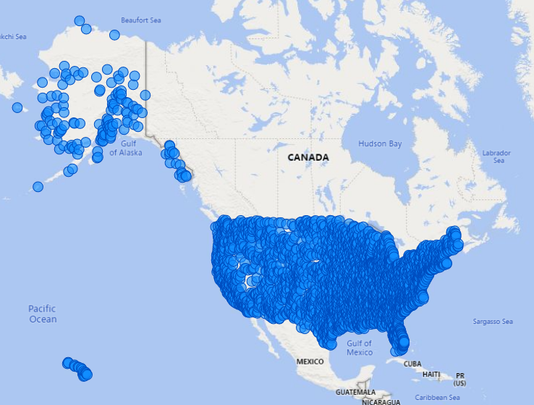
6) World map
These are the geographical areas affected by gun violence according to the latitude and longitude in this dataset:

Slide 22
contents
1) Dataset and Intended Audience
2) Analytical Error
3) Average Age of Participant
4) Participant Age Group Breakdown
5) Participant Gender Breakdown
6) World Map
7) Conclusion

Slide 23
7) conclusion
In conclusion, we hope that the law enforcement officials in the affected areas will take into account the average age, age groups, and genders of the participants in this dataset when making decisions on how to reduce gun violence.

